Slide 1
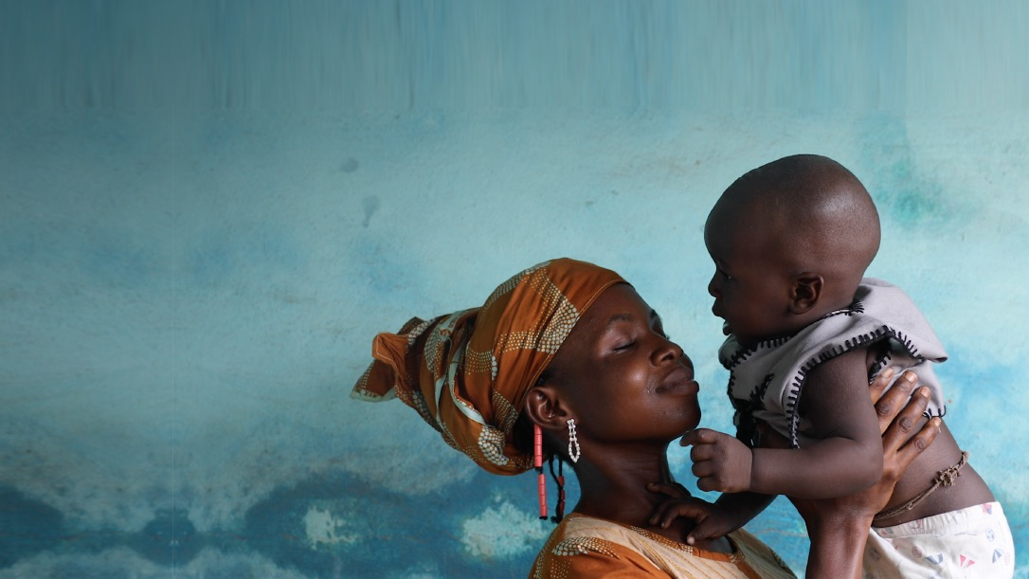

Webinar series #3:
Speedily re-establishing missing elements of children’s identity in emergency situations
Art. 8 (2) CRC
18 February 2025
Karin Heissler, Regional Adviser, UNICEF WCARO
© UNICEF/UN0641754/Orina

Slide 2
POLYCRISIS INDEX
The higher the Polycris Index is, the worse is the risk. Maximum risk is at 10.
NB: Polycrisis Index data is missing for 5 countries (Cote d’Ivoire, Congo Rep, Gambia, Equatorial Guinea and Sao Tome and Principe) due to a lack of data for the Economics Index in those countries.
Figure 1.1: Polycrisis Index map in WCAR countries
Mauritania
6.5
Mali
7.4
Niger
Senegal
7.3
Chad
Gambia
6.0
7.7
Guinea
Bissau
6.6
Guinea
Burkina Faso
6.3
Benin
Sierra Leone
5.8
Nigeria
6.8
Ghana
Togo
6.9
Cabo Verde
Liberia
Côte d'Ivoire
6.4
6.0
Central African Republic
3.9
6.1
Cameroon
8.7
Legend
6.7
[8 - 10]
Equatorial
Guinea
[7 – 8[
Gabon
Congo
Democratic
Republic
of Congo
The highest level of Polycrisis Index is observed in the West and Central Africa Region (6.6) followed by the East and Southern African region (6.3). All regions have an index above the world’s average (4.9) except for the High-Income countries (HICs) (such as Europe and North America) (2.9).
[6 – 7[
5.3
[5 – 6[
7.7
[0 – 5[
No data
Sao Tome
and Principe
Notes:
Humanitarian context and trends in West and Central AfricaThe region is heavily affected by ‘polycrisis’; highest level in the world. These are countries affected by a mix of protracted and acute conflicts, displacement, public health emergencies and conflict change –including floods and drought
Draw attention to: Civil registration in Humanitarian Contexts: Recommendations and Operational Guidelines for African Union Member states (2022) -officially released during the 6th Conference of African Ministers responsible for Civil registration’
Emergencies can infringe on many rights including access to a name and nationality
without birth certificates victims cannot have legal identity to go to court or needed for age verification for recruitment;
can complicate family tracing and reunification processes for children and parents/caregivers who are separated -be it through conflict and/or climate change and public health emergencies
access to other services that may be protective (in humanitarian contexts) such as schoo
3. Access to civil registration services may be hampered by laws and policies that may exclude certain groups
4. Vital events registration systems can become dysfunctional, may collapse, archives and documents may be destroyed, documents may be lost, confiscated. Destroyed

Slide 3
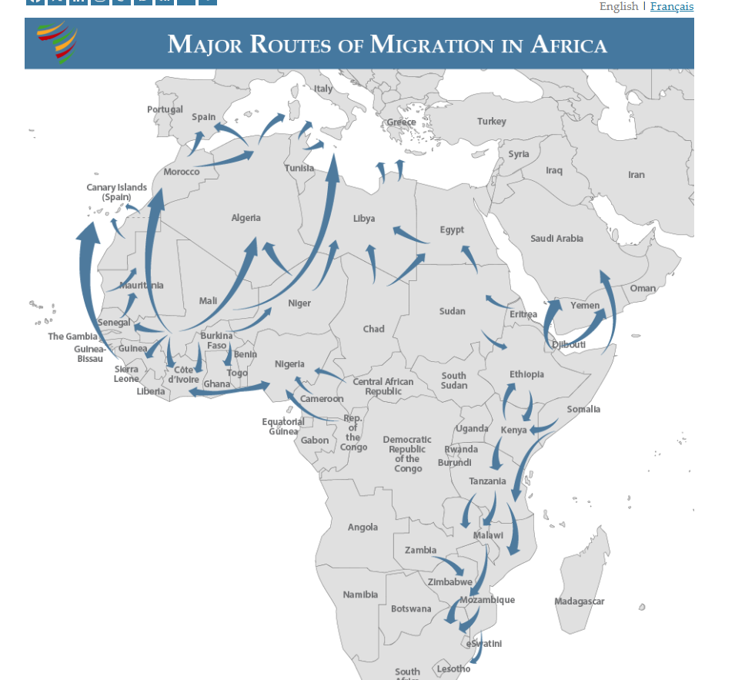
Source: African Migration Trends to Watch in 2025 – Africa Center
Notes:
Increased Informal Migration within Africa
The United Nations (UN) estimates that Africa saw a 25-percent growth of African migrants (excluding refugees and asylum seekers) living in another African country over the last decade (from 12 million in 2015 to 15 million in 2024). While likely an undercount given its informal nature, nearly all internal Africa migration is labor migration in one form or another. This includes seasonal labor movements as well as permanent resettlements in search of livelihoods, typically in urban economic hubs.
Almost half of all Africans have considered emigrating.
Given ongoing push factors of unaccountable governance and limited job opportunities in the face of rising youth populations, Afrobarometer surveys indicate almost half of all Africans have considered emigrating—a significant increase compared to the proportion recorded in 2016/2018.
With Africa’s population predicted to grow by 70 percent by 2050 (to 2.4 billion people), this migratory pressure can be expected to continue—shifting the security, economic, and governance dynamics in each subregion.
The continent is young: 60 per cent are under 25 years old and the proportion of young to old is growing, with the anticipation that by 2050, the continent will have 930 million children, making it the largest child population among all continents. Urbanization across Africa is also growing, with projections that by 2050, the percentage of Africans living in urban areas will reach 60 per cent.

Slide 4
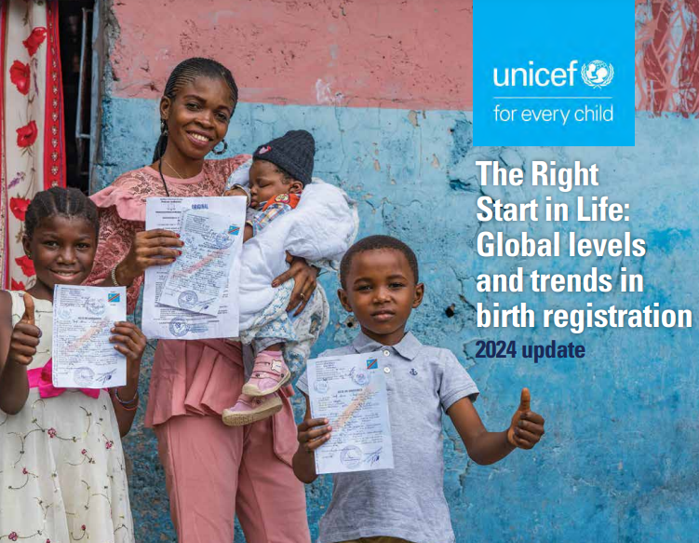
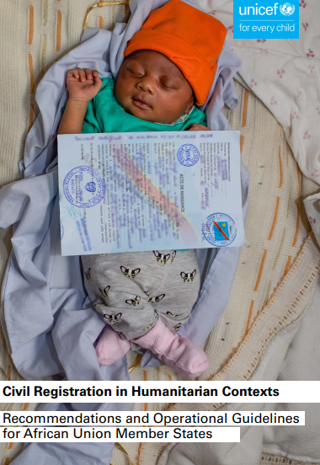
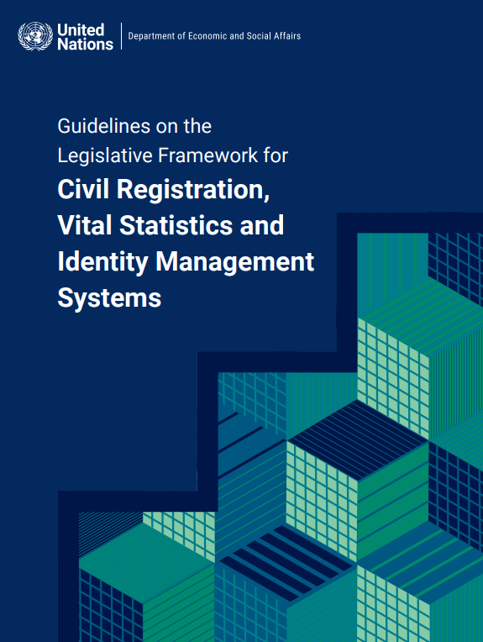
Data, guidance and tools
CRVS Humanitarian final.pdf
CRVS_GOLF_Final-E.pdf
Notes:
Documents to refer to:
UNICEF (December 2024) ‘The Right Start to Life’ -latest global updates on birth registration and noting it is the indicator for SDG 16.9 on legal identity (proportion of children under 5 registered…) https://data.unicef.org/resources/the-right-start-in-life-2024-update/
UNICEF recommendations for ‘Civil registration in Humanitarian Contexts: Recommendations and Operational Guidelines for African Union Member states (2022) -officially released during the 6th Conference of African Ministers responsible for Civil registration’
Recommendations have been developed in four categories.
enabling environment, in particular laws and policies, to ensure that registration is free of charge, with simplified procedures to reduce the burden imposed by the humanitarian context.
institutional arrangements that need to be put in place to ensure continued service delivery in humanitarian contexts, with a special focus on coordination mechanisms and interoperability.
measures to allow secure storage, the protection of records and the reconstitution of registers, including, but not limited to, the digitalization of systems. –ensuring civil registrars are identified as being part of ‘essential workers and services’
humanitarian mechanisms and coordination among partners, including the integration of civil registration and vital statistics in national disaster preparedness and response mechanisms and plans; the strengthening of evidence; and the facilitation of cross-regional forums for the exchange of experiences and good practices

